Slide 1
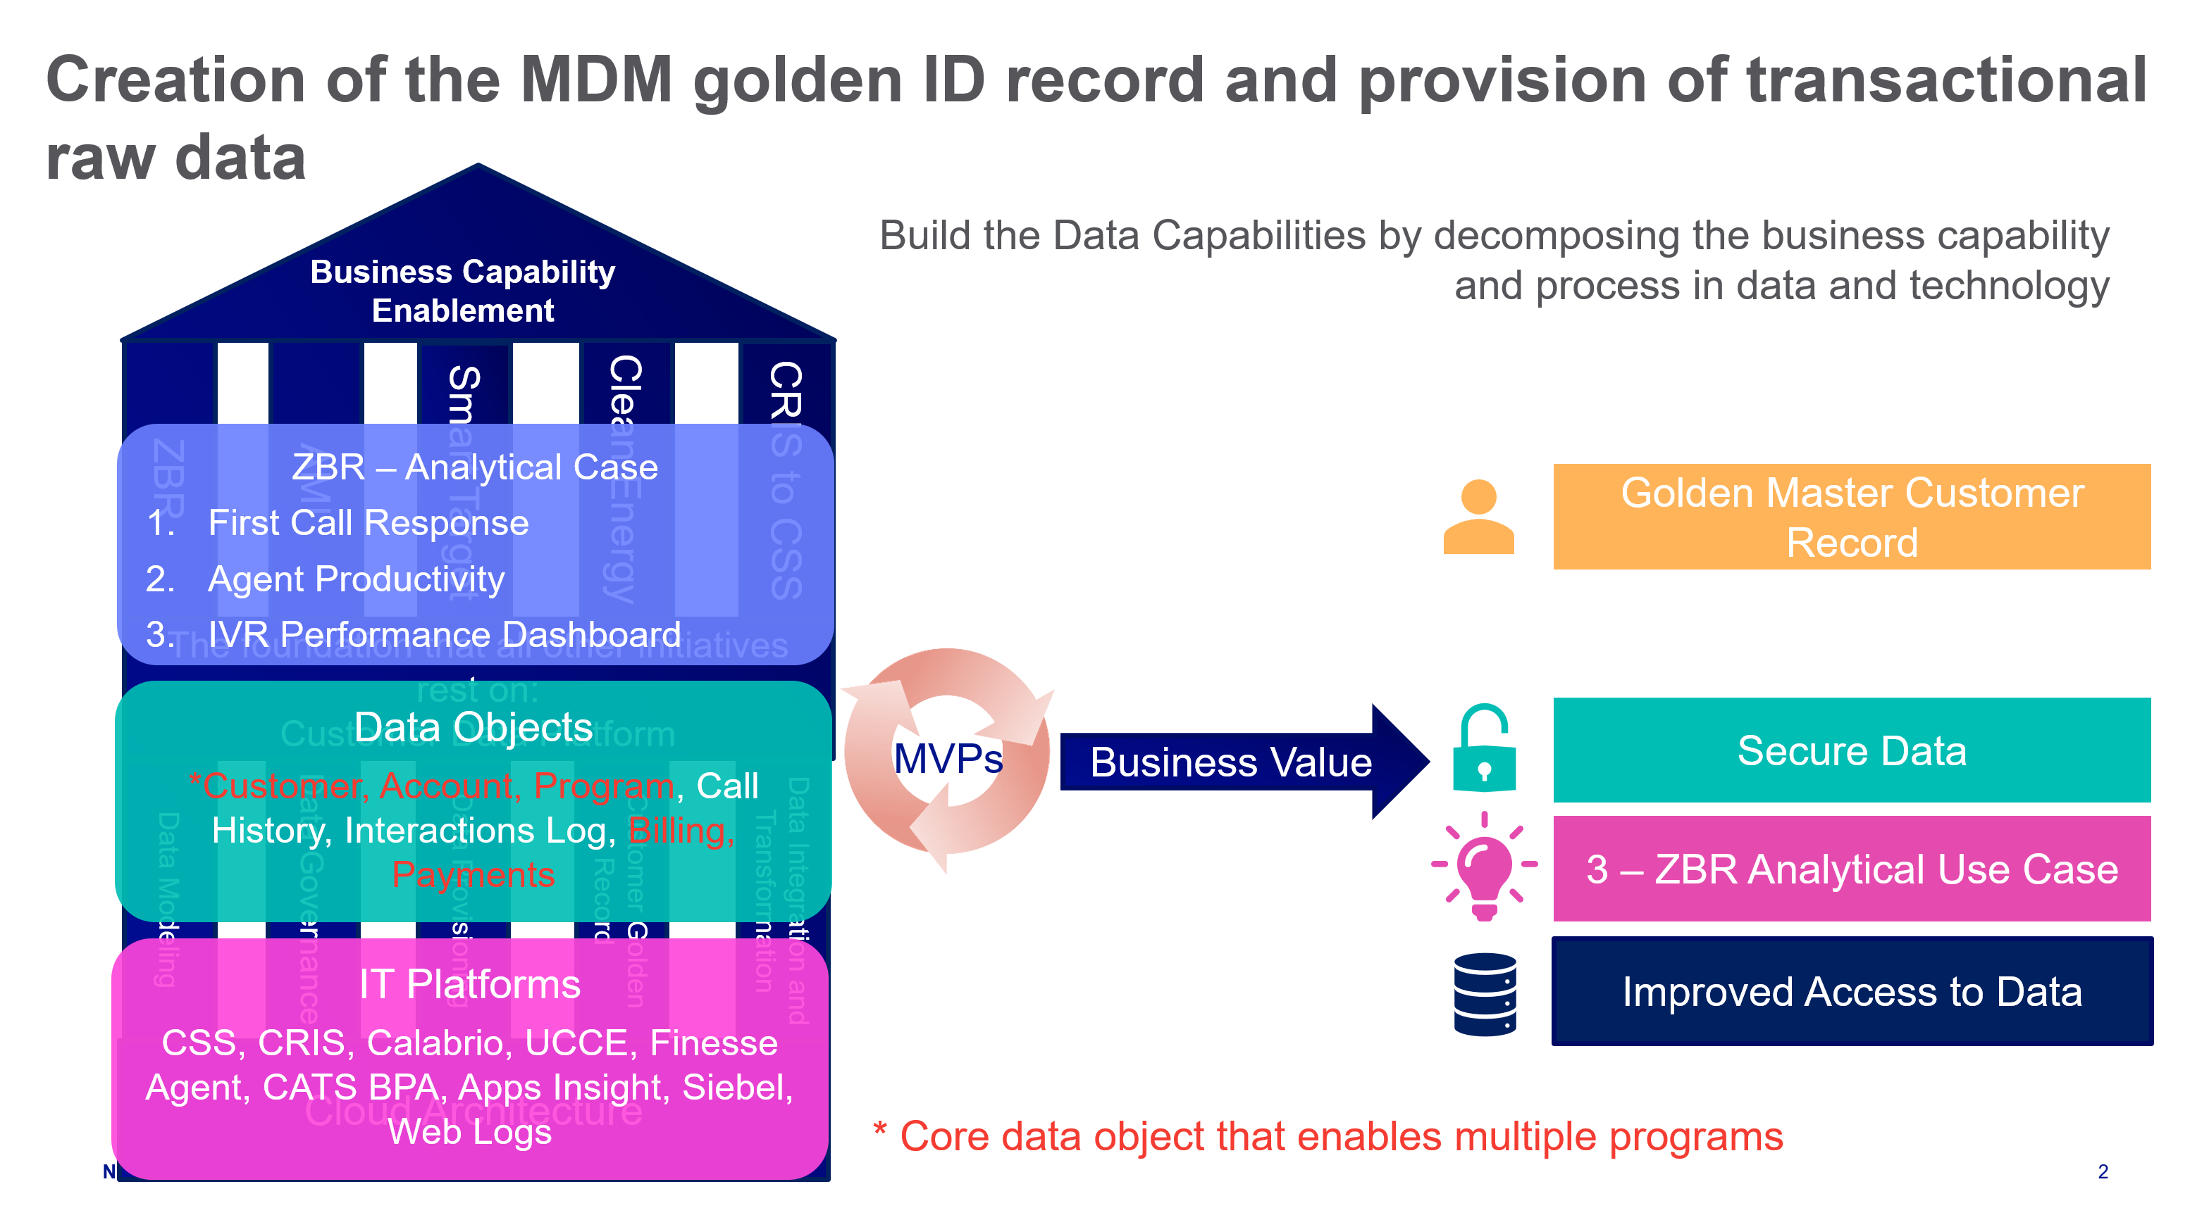
Customer Data Platform Project
In August 2020, the Customer & IT teams completed an assessment and solution design of the Customer Data domain.
The assessment showed an extremely poor state: a maturity level of 1.46 vs. a target state of 3.2 in FY25 (on 5-point scale).
The target state is a pre-requisite to efficiently and effectively:
support the customer agent experience;
develop capabilities previously discussed (Customer Digital, ZBR, Clean Energy, Smart Target, AMI, etc.);
meet regulatory requests;
provide the analytics required for revenue and collection growth opportunities; and
accelerate transition from CRIS to CSS mainframe systems supporting a more cost-effective migration off CRIS.
The solution is to create enterprise data capabilities by implementing new technologies and a comprehensive source of high-quality Customer Data from all underlying systems, and to update and maintain this data in a largely automated manner, as well as to create the required governance and quality control tools and processes. The approach is agile, with value drops every sprint cycle or MVPs, tailored to support the Contact Center operations, Digital, and CXP value cases.
Executive Summary
Project Status
Finance (Budget and Actual)
Resources
Schedule
Scope
MVP 1 Scope
Key Risks, Issues, Watch Items​ | Due Date
Data Governance Team not fully staffed​ | ​09/30
Database error when try to connect to CSS Server | 08/27
CSS – Firewall request has not been completed | 09/30
Project financial report budget vs actual is in progress and to be delivered at the end of every month | 10/28

